Slide 1
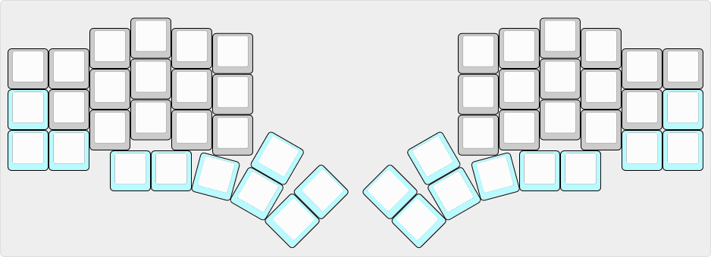
Thumb keys
L 0
L 3
Space
L 1
Space
Space
Enter
GUI
Enter

